Slide 1
Algorithm Theoretical Project Presentation
Topic : Smart City Transportaion
By :
Ahmed Mohamed Fawzy , ID:23101889
Abanob Yousry Fahmy , ID:23101861
Mahmoud Ismail Elsaid Ismail , ID:23101596
Belal Ashraf Mostafa zaki , ID:23101559
Ahmed Tharwet abd elhamed , ID:23101351

Slide 2
Introduction:
There are many problems with current transportation systems in the world such as :
Severe traffic congestion during peak hours
Delays in emergency response vehicles
Inefficient public transportation scheduling
High infrastructure development costs
Difficulty managing dynamic traffic conditions
This project presents a complete intelligent transportation optimization system for Cairo using graph algorithms, dynamic programming, and optimization techniques.
The goal of this project : Develop a smart transportation management system capable of optimizing routing, infrastructure, traffic flow, and public transportation efficiency.

Slide 3
Implemented Algorithms:
We Implemented Multiple Algorithms in this project such as :
Minimum Spanning Tree algorithms (Both Kruskal’s AND Prim's)
Shortest Path algorithms (Dijkstra’s AND A*)
Dynamic Programming solutions for scheduling or resource allocation
Greedy algorithms for some optimization problems .

Slide 4
Minimum Spanning tree (MST):
Core Idea -> Given a connected weighted graph of G=(V,E)
Find a subset of edges that:
Connects all vertices
Contains no cycles
Minimizes total edge weight
We Implement Kruskal's and Prim's algorithms with modifications for
infrastructure network design, prioritizing high-population areas
and critical facility connectivity.
Complexity Analysis:
Kruskal's: O(E log E) time , Prim's: O(E log V) time

Slide 5
Minimum Spanning tree (MST):
Prim’s MST :
Prim grows the MST vertex by vertex.
It starts from one node and repeatedly Selects the minimum-weight edge
That connects a visited node to an unvisited node. This approach is considered Greedy-aligned in Nature.
Prim’s Pseudo Code
Start from any vertex
Mark it visited
Find smallest edge leaving the visited set
Add that edge + new vertex
Repeat until all vertices are included

Slide 6
Minimum Spanning tree (MST):
Kruskal’s MST :
Kruskal grows MST edge by edge.
It Sorts all edges by weight , Adds smallest edge , Skips edges that create cycles
Kruskal’s Pseudo Code:
Sort edges ascending
Start with empty MST
Pick smallest edge
If no cycle forms → add it
Repeat until MST has V−1 edges

Slide 7
Shortest Path algorithms(Dijkistra):
Finds shortest path by exploring uniformly outward , selecting the closest (shortest) path at time of traversal .
It does not know where the goal is.
Dijkistra’s Pseudo Code:
Start from source node
Maintain a set S of selected vertices
At each step select closest , shortest path vertex , add it to S, and perform relaxation for all adjacent unselected vertices to That vertex .
Repeat step 3 until selecting all vertices
Time Complexity : O((V+E)logV)

Slide 8
Shortest Path algorithms(A*):
Uses actual distance traveled , an estimate of remaining distance (Heuristic) So that it searches toward the goal.
A*’s Pseudo Code:
Push source node into priority queue
While queue not empty:
Extract node with lowest f(n) // f(n)=g(n)+h(n)
If destination reached:
return path
For each neighbor:
Calculate new cost
Update if better path found
Time Complexity : O((V+E) log V) at worst case

Slide 9
Dynamic Programming :
Dynamic Programming is a method used to solve complex problems by breaking them down into simpler subproblems. By solving each subproblem only once and
storing the results, it avoids redundant computations.
Dynamic Programming General Flow:
1. Break down the complex problem into simpler subproblems
2. Find optimal solution for these subproblems
3. Store the results of subproblems (Memoization/Tabulation)
4. Reuse them so that same subproblem is not calculated more than once
5. Finally calculate the result of complex problem

Slide 10
Greedy Algorithms:
Greedy Algorithms make locally optimal choices in an attempt for achieving Optimal output. It’s Used for Traffic Signal Optimization and Emergency Vehicle Pre-Emption .
Greedy Problems General Flow:
Find Starting Soloution.
while Problem is not complete:
choose best available option/path to Soloution
if choice is valid:
add it to solution
return Soloution

Slide 11
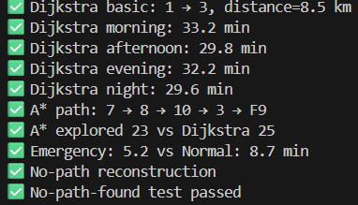
Performance Analysis Results:
When Comparing Dijkistra to A* , we find that Dijkistra Traverses more nodes to find Shortest Path , Taking a small amount of time more than A* .
Meanwhile , A* Explored much less nodes to arrive at solution , taking much less time and becoming more appropriate for Emergencies .

Slide 12

Performance Analysis Results:
When Looking At Greedy Performance , we find that it managed to optimize Routes and Traffic Signal . Managing to optimize many traffic Signal Intersections and Saving valuable time for Emergency Pre-Emption .

Slide 13
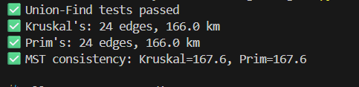
Performance Analysis Results:
When Observing MST Performance . We find that Both Kruskal and Prim’s Algorithms Both manage to find MST within Similar time and Resources . Proving Both Algorithms can handle MST extraction in similar Performance consistently .

Slide 14
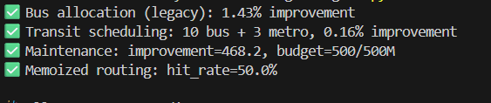
Performance Analysis Results:
When Observing Performance of the Dynamic Programming Algorithms responsible for public transit scheduling, road maintenance allocation, and memoized routing , We find that DP has managed to obtain some improvement in most Cases .

Slide 15
Thank You

